Slide 1

The Best Duo 2014 - 2015

Slide 2

Unlucky Days
Sometimes, things may go in the other direction…

Slide 3

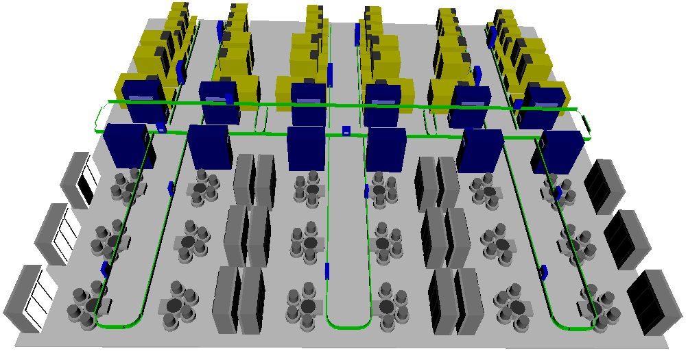
Soccer Teams vs. Queueing Networks
In soccer teams
  Contribution
    Scoring
    Assistance
  Chemistry
In queueing networks
  Dependence
Notes:
Single player (Bale) vs. his performance in a team

Slide 4
Dependence among Single Queues in Series
Kan Wu

Slide 5
Dependence in Queueing Networks
Dependence among stations
  Positive: reduce system queue time
  Negative: increase system queue time
Queue time classification
  Actual queue time
    The queue time performance in appearance
    The total score a player get
  Contribution queue time
    The authentic contribution to the system
    The effort a player contributed to the total score of the team

Slide 6
Reduction Method
Friedman tandem queue (1965)
  Constant service time (c_{s} = 0)
  System queue time is solely determined by the bottleneck
    = Bottleneck QT when it is a single server system
    Actual QT₁ = 20 Actual QT_{BN} = 80
    Contribution QT₁ = 0 Contribution QT_{BN} = 100
  Fully coupled system
QT_{BN} = 100
QT₁ = 20
QT_{BN} = 80
λ
BN
λ
1
BN

Slide 7
Jackson Network
Under Markovian assumptions
  Exponential service time (c_{s} = 1) with Poisson arrivals
  Each station behaves independently in the steady state
    Actual QT₁ = 20 Actual QT_{BN} = 100
    Contribution QT₁ = 20 Contribution QT_{BN} = 100
  ASIA (all see initial arrivals) system
QT_{BN} = 100
QT₁ = 20
QT_{BN} = 100
λ
BN
λ
1
BN

Slide 8
ASIA and Fully Coupled Systems
N single sever in series
ASIA and Fully coupled systems
λ
1
2
3
Ν
…
S₁
S₂
S₃
S_{N}
(λ, c_{a1})
1
Actual queue times
…
(λ, c_{a1})
(λ, c_{a1})
BN₁
1
…
BN_{k}
…
BN₁
…
(λ, c_{a1})
N
Contribution queue times

Slide 9
General Situation
In general, contribution queue time can be obtained through the concept of intrinsic ratios.

Slide 10

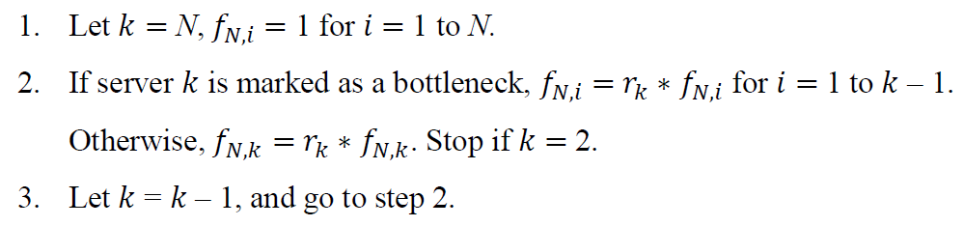
Contribution Queue Time
Conservation of queue time
  Contribution is relative to the ASIA queue times
Computation of Contribution Factor
Notes:
Contribution is relative to the ASIA queue times

Slide 11
Dependence in Tandem Queues
Uni-Direction dependence
  Decentralized dispatching policy with local information
  The states of downstream stations have no impact on the dispatching decisions of the upstream stations.
Diffusion vs. Blocking
  Diffusion: actual queue time increases due to the upstream stations.
  Blocking: actual queue time decreases due to the upstream stations.
  Quantified through contribution queue time…
λ
S₁
S₂
S₃
S_{N}
…

Slide 12
Case study: Diffusion on Bottlenecks
Poisson arrivals with mean 33 1/3 min
Service times: 20 – 23 – 25 – 28 – 30
SCVs: 8 – 0.8 – 0.8 – 0.8 – 0.4
  Bottleneck is the last station
Actual queue times: 135.18 – 124.96 – 101.67 – 172.46 – 220.35
ASIA system QTs: 135.00 – 46.07 – 67.50 – 132.30 – 189.00
λ
S₁
S₂
S₃
S₃
S₅
Notes:
Bottleneck is in an increasing order

Slide 13
Diffusion on Bottlenecks – First 2 Stations
Actual queue times: 135.18 – 124.96
ASIA system QTs: 135.00 – 46.07
Contribution QTs: 214.07 – 46.07
λ
S₁
S₂
Notes:
Total actual QT = Total Contribution QT

Slide 14
Diffusion on Bottlenecks – First 3 Stations
Actual queue times: 135.18 – 124.96 – 101.67
ASIA system QTs: 135.00 – 46.07 – 67.50
Contribution QTs: 242.19 – 52.12 – 67.50
λ
S₁
S₂
S₃

Slide 15
Diffusion on Bottlenecks – All 5 Stations
Actual queue times: 135.18 – 124.96 – 101.67 – 172.46 – 220.35
ASIA system QTs: 135.00 – 46.07 – 67.50 – 132.30 – 189.00
Contribution QTs: 284.86 – 61.31 – 79.39 – 140.06 – 189.00
Notes:
Contribution QTs are longer than the ASIA system QTs

Slide 16
Block on Bottlenecks – All 5 Stations
Service times: 20 – 23 – 25 – 28 – 30 with Poisson arrivals & SCVs 0.25 for all
Actual queue times: 18.75 – 22.88 – 30.37 – 63.47 – 116.73
ASIA system QTs: 18.75 – 32.00 – 46.88 – 91.88 – 168.75
Contribution QTs: 2.17 – 7.20 – 17.48 – 56.59 – 168.75
Notes:
Contribution QTs are less than the ASIA system QTs

Slide 17

Second Moment Result on TOC
Service times: 28 – 26 – 24 – 22 – 30 with SCVs 0.8
Poisson arrivals
If the SCVs can be reduced by half, which one should be the 1st?
    : Service time SCV of station i is reduced by p (in percentage)
λ
S₁
S₂
S₃
S₃
S₅

Slide 18
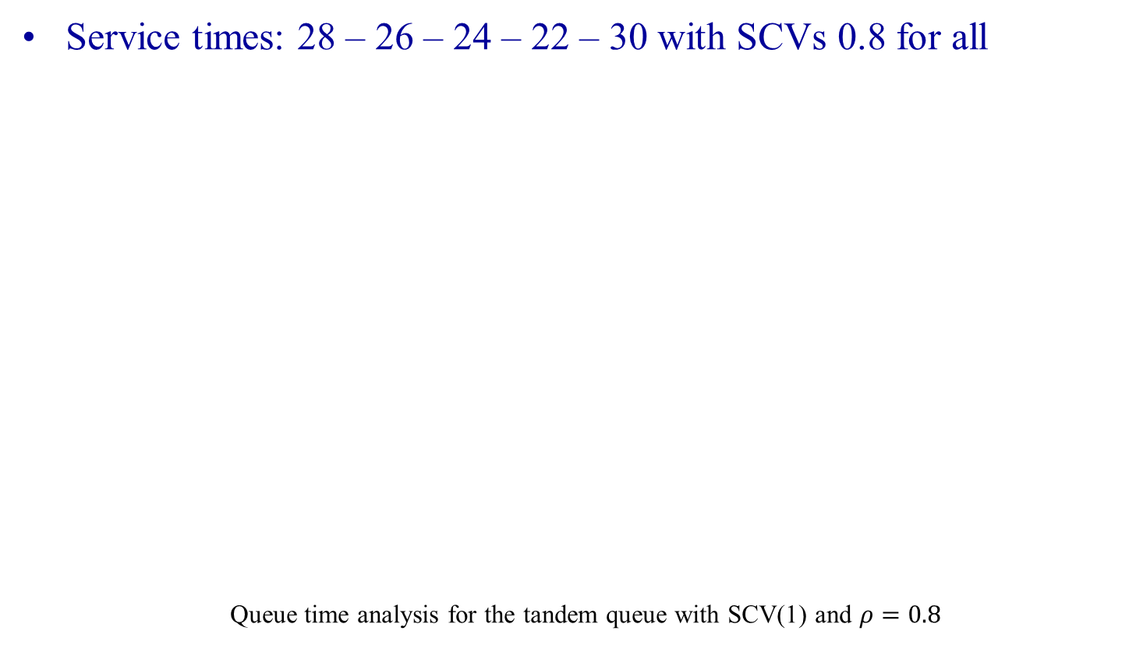
Second Moment Result on TOC
Notes:
Improvement can be started from the furnace

Slide 19
Summary
Dependence among tandem queues
  Actual queue time vs. contribution queue time
  Blocking and diffusion effects
  Dependence cannot be captured by the product-form and Brownian networks
Theory of constraint
  Utilization should be strictly less than 1 in the long run
  Total sojourn/cycle time is the true limit
    Improving the performance of the system bottleneck may not be the most effective place to reduce system cycle time
  Improvement should start from the system bottleneck or upstream stations

Slide 20

Thank you
~ Just like human beings, a server has its life in a queueing network. ~

Slide 21
Defense Acquisition Program
Assembly
Batching
Dispatching
Shift Schedule

Slide 22
Approximate Model for System Cycle Time
  k₁: α_{BN}
  k₂’: Variability of the (n - 1) non-bottleneck (in ASIA systems)
  k₃: Non-bottleneck capacity

Slide 23
Regression Results
k₁ = 0.356
k₂ = 422.951
k₃ = 14.636
BN Cap = 13.7
G/G/1 model
YAN’s model
  Yang, Ankenman and Nelson (2007)

Slide 24
Model for Multiple-Server Stations
k₁: by historical bottleneck queue time in heavy traffic.
  by Sakasegawa (1977)
k₃: capacity of the 2nd bottleneck, i.e.
k₂: by historical factory cycle time

Slide 25
System with Multiple Servers
m = 5
k₁ = 0.087
k₃ = 248.276

Slide 26
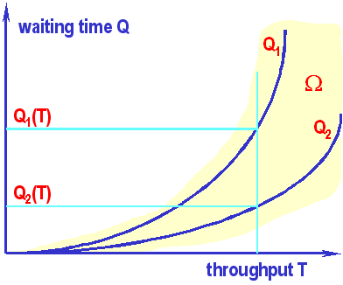
The Intrinsic Gap and Intrinsic Ratio
Intrinsic Gap (IG):
  The queue time difference between the ASIA
  and BSIA systems.
Intrinsic Ratio (IR):
  If c_{s} = 0 => actual QT = QT in BSIA => IR is 0
  In Jackson networks
  => actual QT = QT in ASIA system => IR is 1
QT in ASIA
Actual QT
IG
QT in BSIA
0

Slide 27
Structures of STQB
(μ₁, c_{s1})
(μ₂, c_{s2})
ASIA:
BSIA:
Intrinsic Gap:
Intrinsic Ratio:
(λ, c_{a1})
1
(λ, c_{a2})
BN
QT₂
r

Slide 28
Simulation: Near-Linearity of the IR in STQB
  STQB with Poisson Arrivals (with c_{s} < 1)
  10B ~ 100B data points in heavy traffic
For different (m₁, c_{s1}, c_{s2}) combinations
Notes:
2nd QT in ASIA system => Upper bound (by observation)
2nd QT in fully coupled system => Lower bound

Slide 29
Robustness & Heavy Traffic Property in STQB
IG = QT₁
QT₂
  M/M/1 queues for 1/μ₁ = 25, 1/μ₂ = 30 (BN)
1
BN
QT₂ in ASIA
QT₂
IG
QT₂ in BSIA
0

Slide 30
Two Important Properties of STQB
The intrinsic ratio is approximately linear across most traffic intensities
  Nearly-Linear Relationship
Robustness in heavy traffic
Approximation

Slide 31
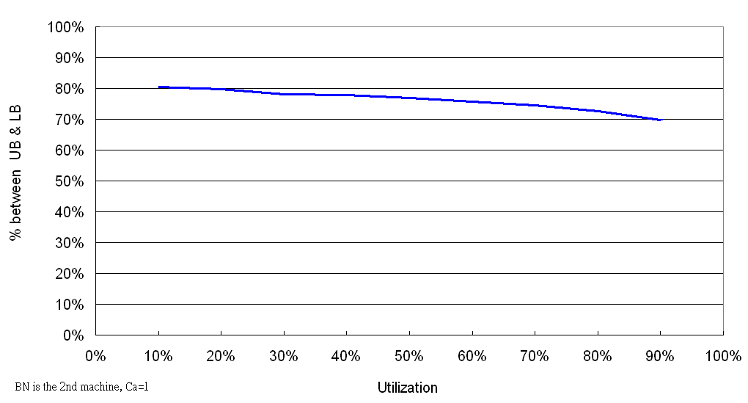
Approximate Model for STQB
  Let y₂ = c_{s1}
  Compared with simulation
    Errors = 3.3% (when c_{s} < 1, arrival process is Poisson)
    vs. 11.0% for QNA and 13.1% for QNET
Back

